Slide 1
Session 2 at atmega

Slide 2
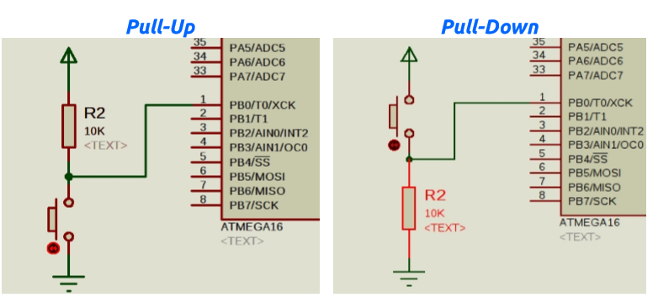

Slide 3
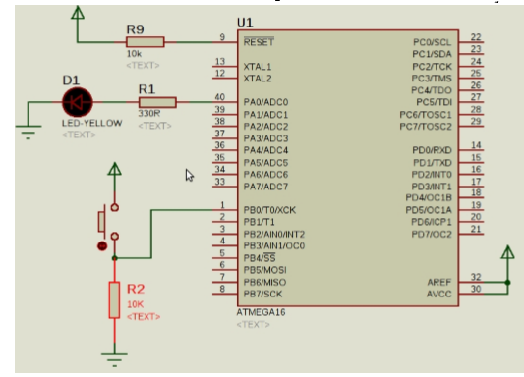

Slide 4
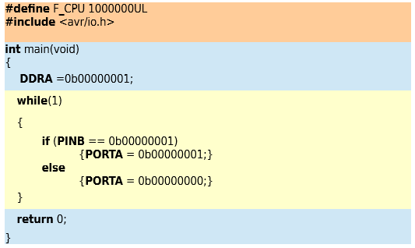
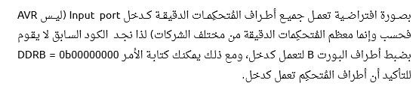

Slide 5
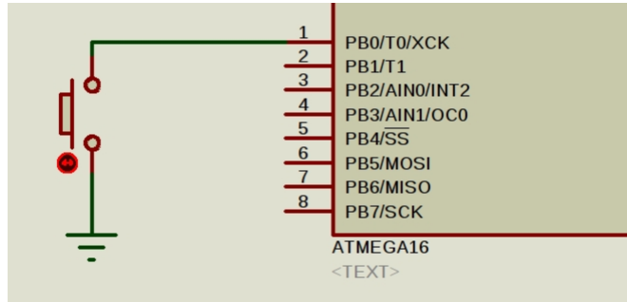
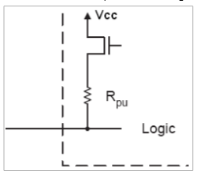
Internal pull up

Slide 6
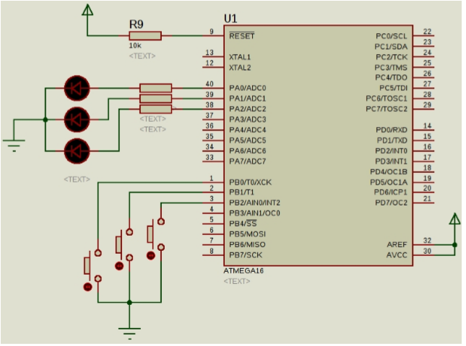

Slide 7
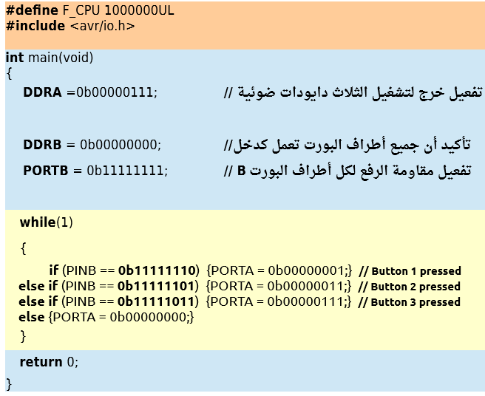

Slide 8
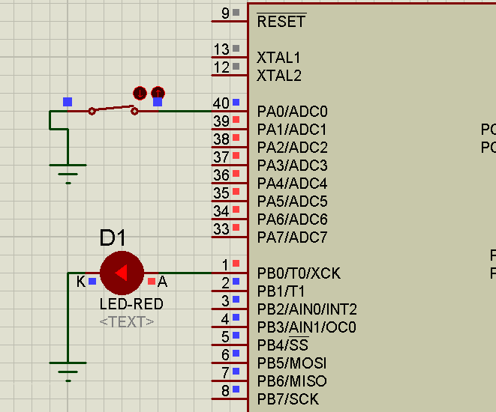

Slide 9
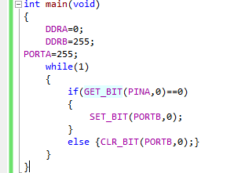
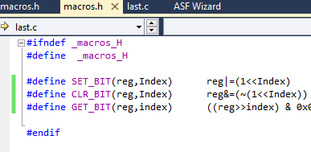

Slide 10
#define GET_BIT(reg,index) ((reg>>index) & 0x01)
Reg (pinA)---→obxxxxyxxx
Shift(index 3)->0bxxxxxxxy
And with one ->0b00000001 -------------------------------------- AND-----------→0b00000000y the final value of ( get

